Slide 1
WELCOME
ITEM LANDING

Slide 2
OBJECTIVE
To design and develop a Product Landing Page using HTML and CSS.
To showcase a product and its key features in an attractive manner.
To encourage users to learn more about or purchase the product.
To improve skills in webpage design and front-end development.

Slide 3
TOOLS USED
HTML- TO CREATE A STRUCTURE OF LOGIN PAGE
CSS- TO STYLE THE LOGIN PAGE
VISUAL STUDIO CODE- CODE EDITOR USED FOR DEVELOPMENT
WEB BROWSER- TO VIEW THE LOG IN PAGE

Slide 4
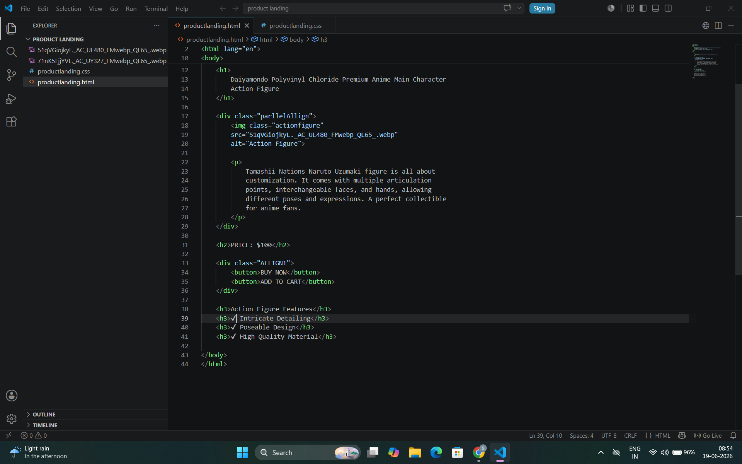
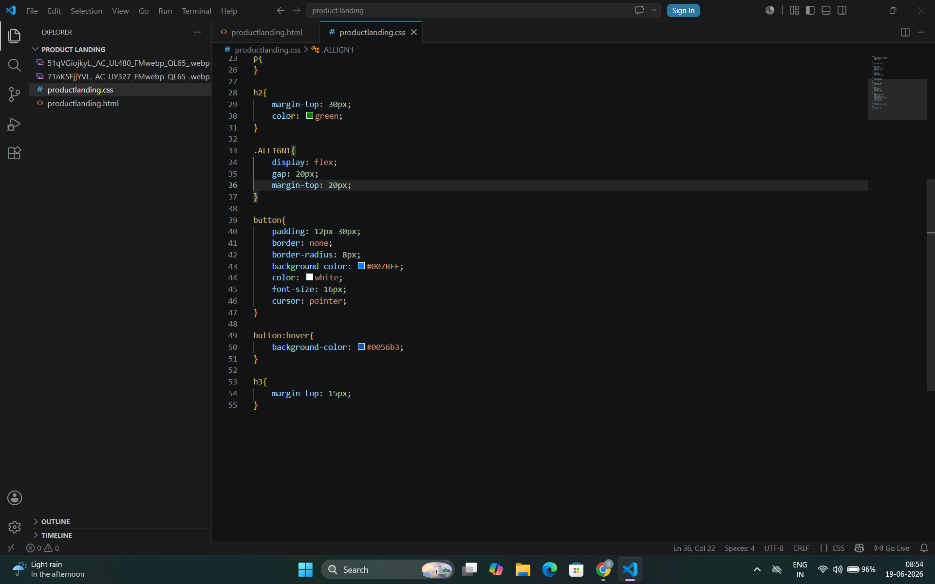
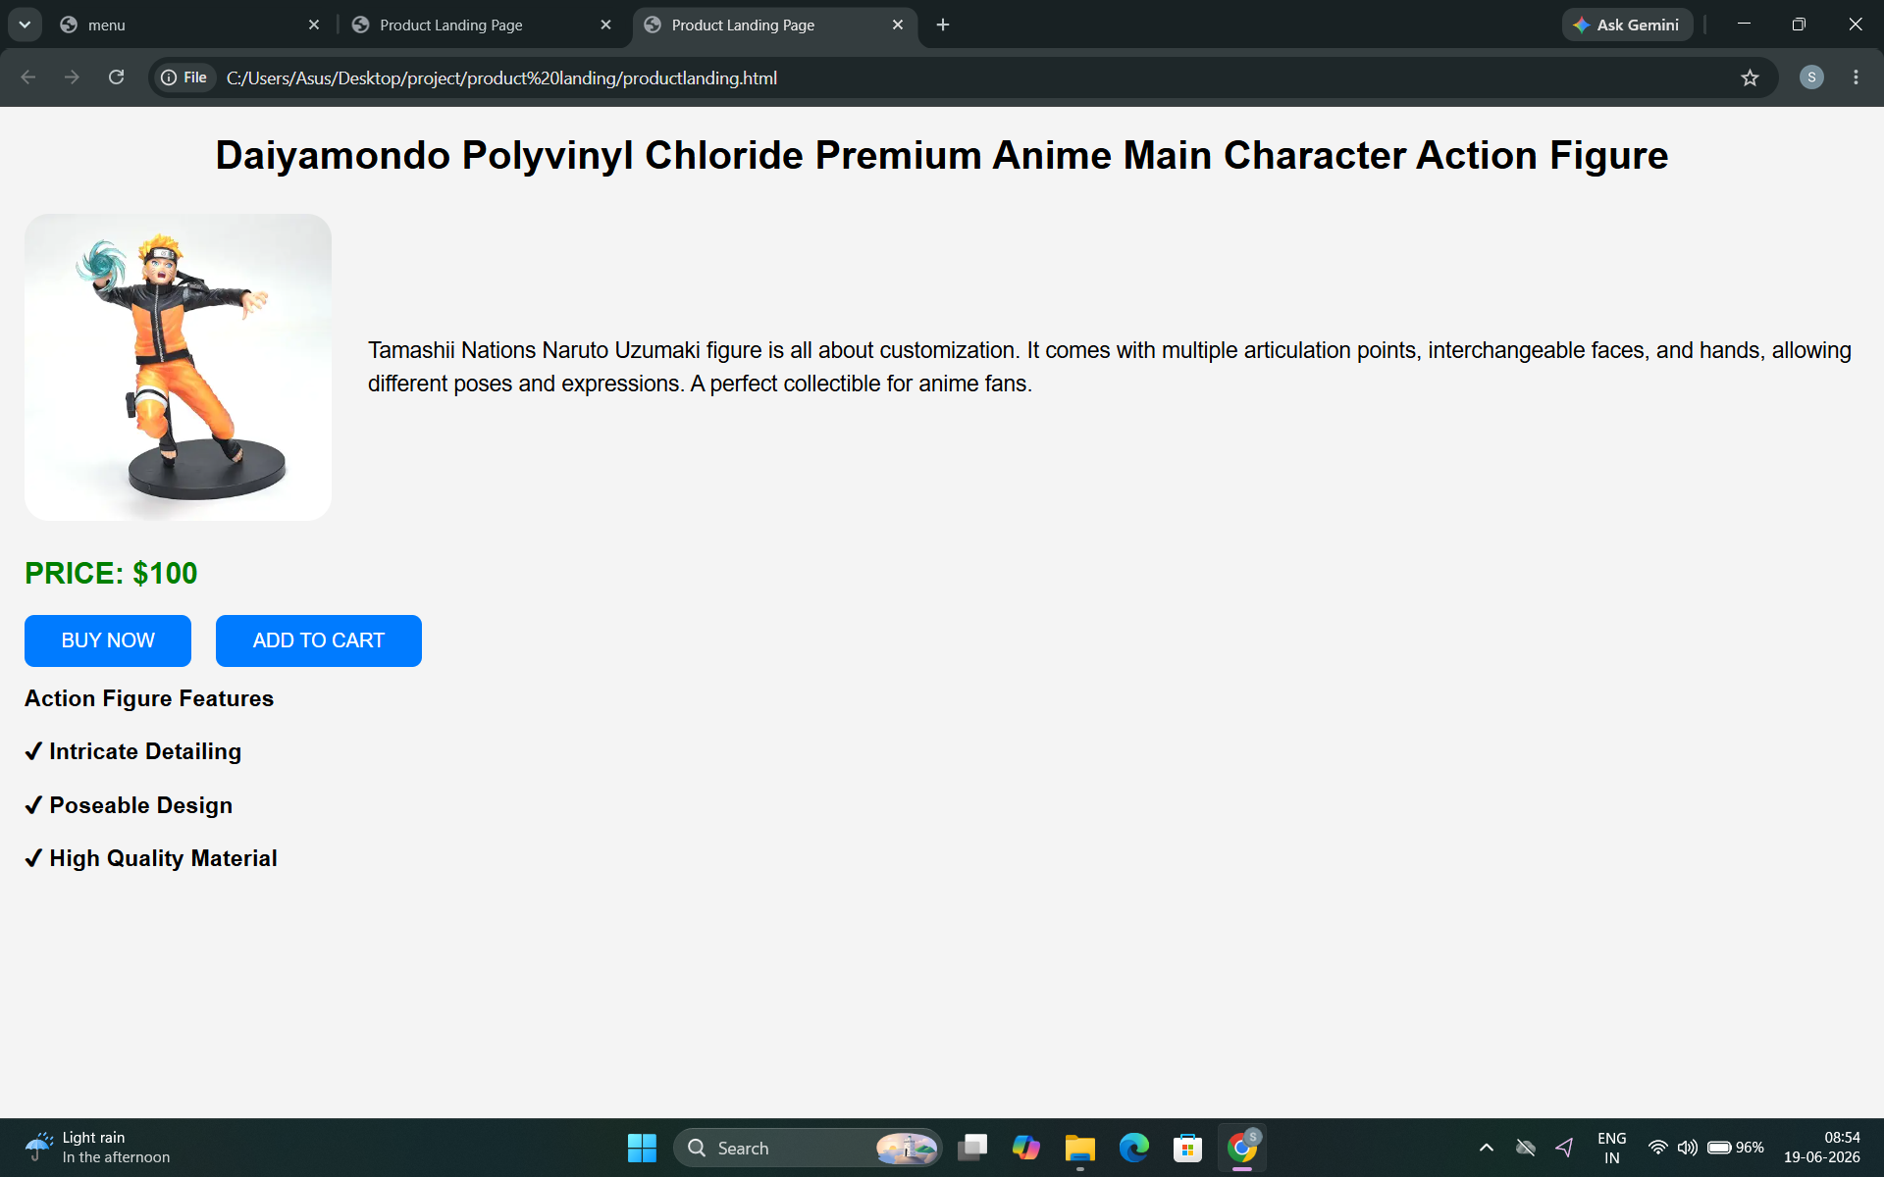
SCREEN SHOTS

Slide 5
THANKYOU

